Slide 1
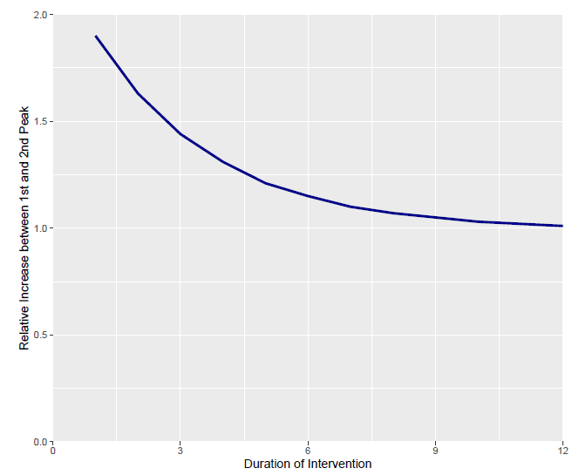
First Peak at I(t = 110) = 0.0276
Intervention Duration | I(t) at Second Peak | Relative Increase in I(t) between Peaks | Days Between Peaks
1 Week | 0.05252755 | 1.90 | 55
2 Weeks | 0.04506779 | 1.63 | 71
3 Weeks | 0.03980539 | 1.44 | 88
4 Weeks | 0.03610702 | 1.31 | 106
5 Weeks | 0.03351064 | 1.21 | 125
6 Weeks | 0.03168779 | 1.15 | 143
7 Weeks | 0.03041102 | 1.10 | 162
8 Weeks | 0.02951546 | 1.07 | 180
9 Weeks | 0.02889002 | 1.05 | 198
10 Weeks | 0.0284516 | 1.03 | 217
11 Weeks | 0.02814524 | 1.02 | 235
12 Weeks (Baseline) | 0.02792261 | 1.01 | 253

